Slide 1


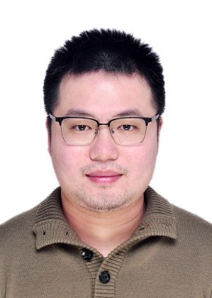

Robust d-wave superconductivity from the Su-Schrieffer-Heeger-Hubbard model: possible route to high-temperature superconductivity
Hao-Xin Wang(王昊昕)
Tsinghua University
HXW, Y.-F. Jiang and Hong Yao , arXiv:2211.09143
HXW, Y.-M. Wu, Y.-F. Jiang and Hong Yao, arXiv:2211.02031
Collaborators:
Hong Yao
(Tsinghua)
Yi-Fan Jiang
(ShanghaiTech)
Yi-Ming Wu
(Stanford)
CUHK, Feb 28, 2023

Slide 2
Outline
Introduction to the superconductivity and the puzzle in high temperature superconductivity
The d-wave superconductivity in SSHH model
Summary

Slide 3
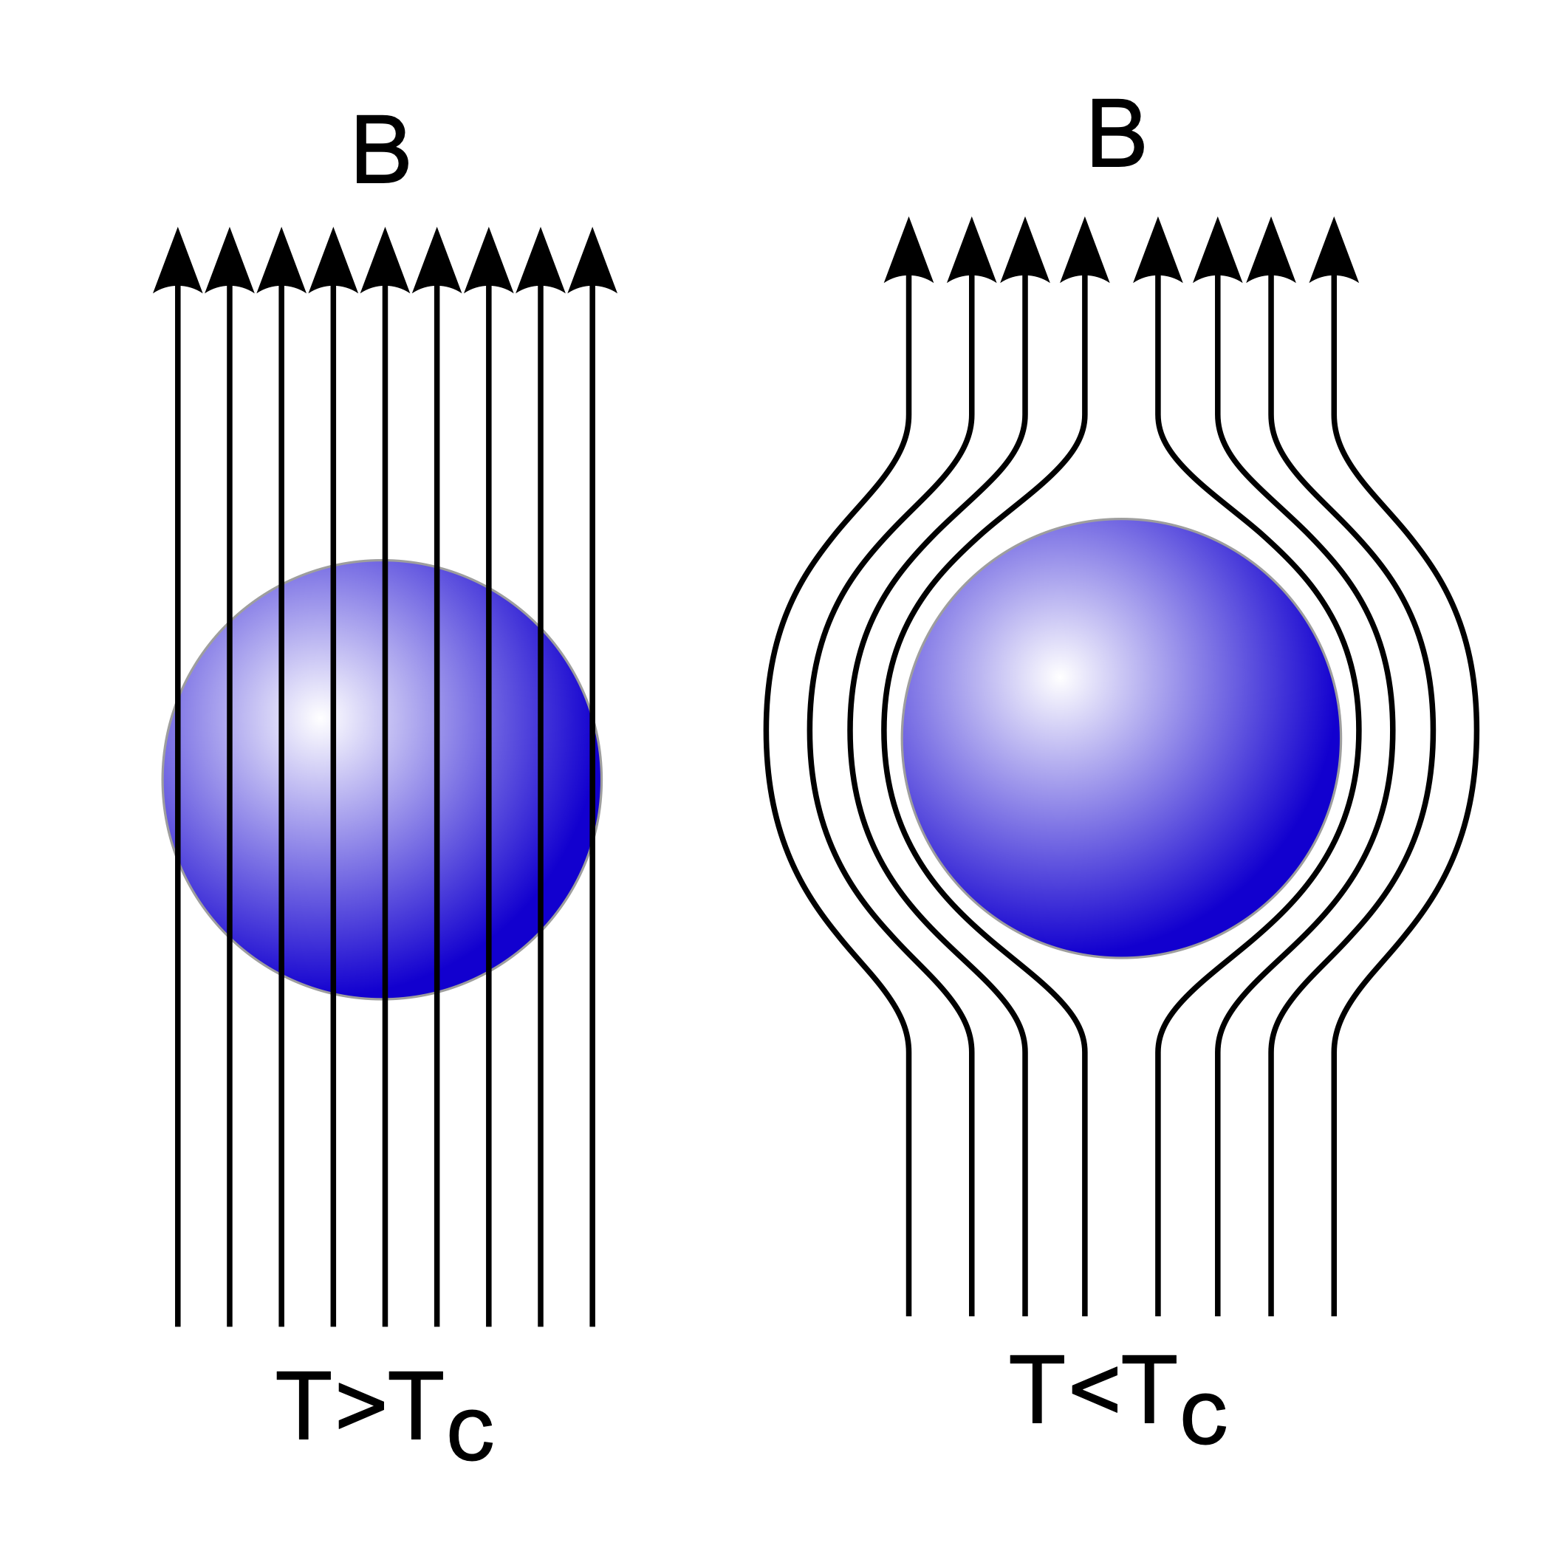
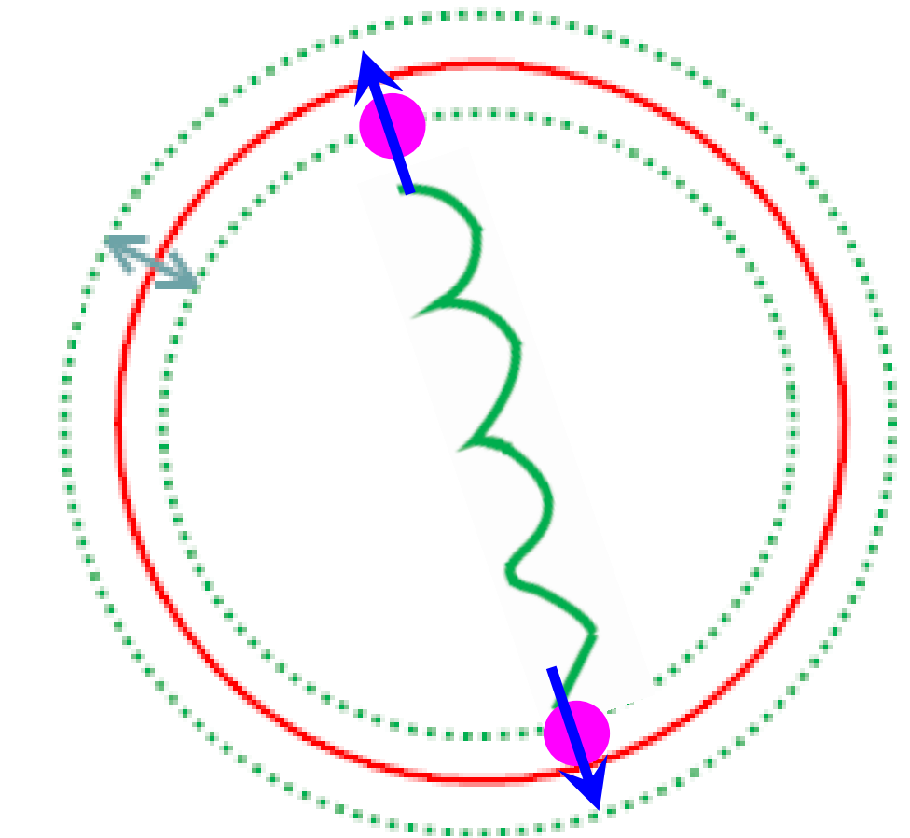
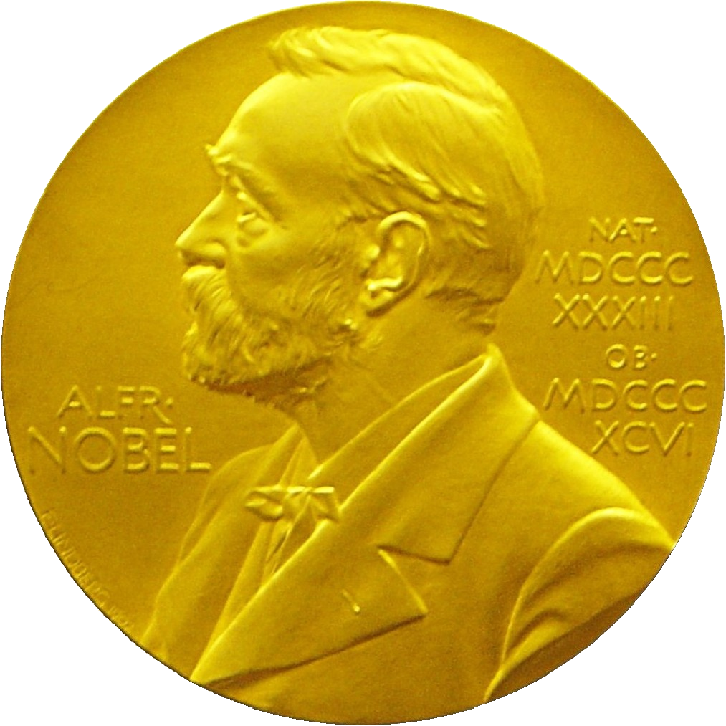
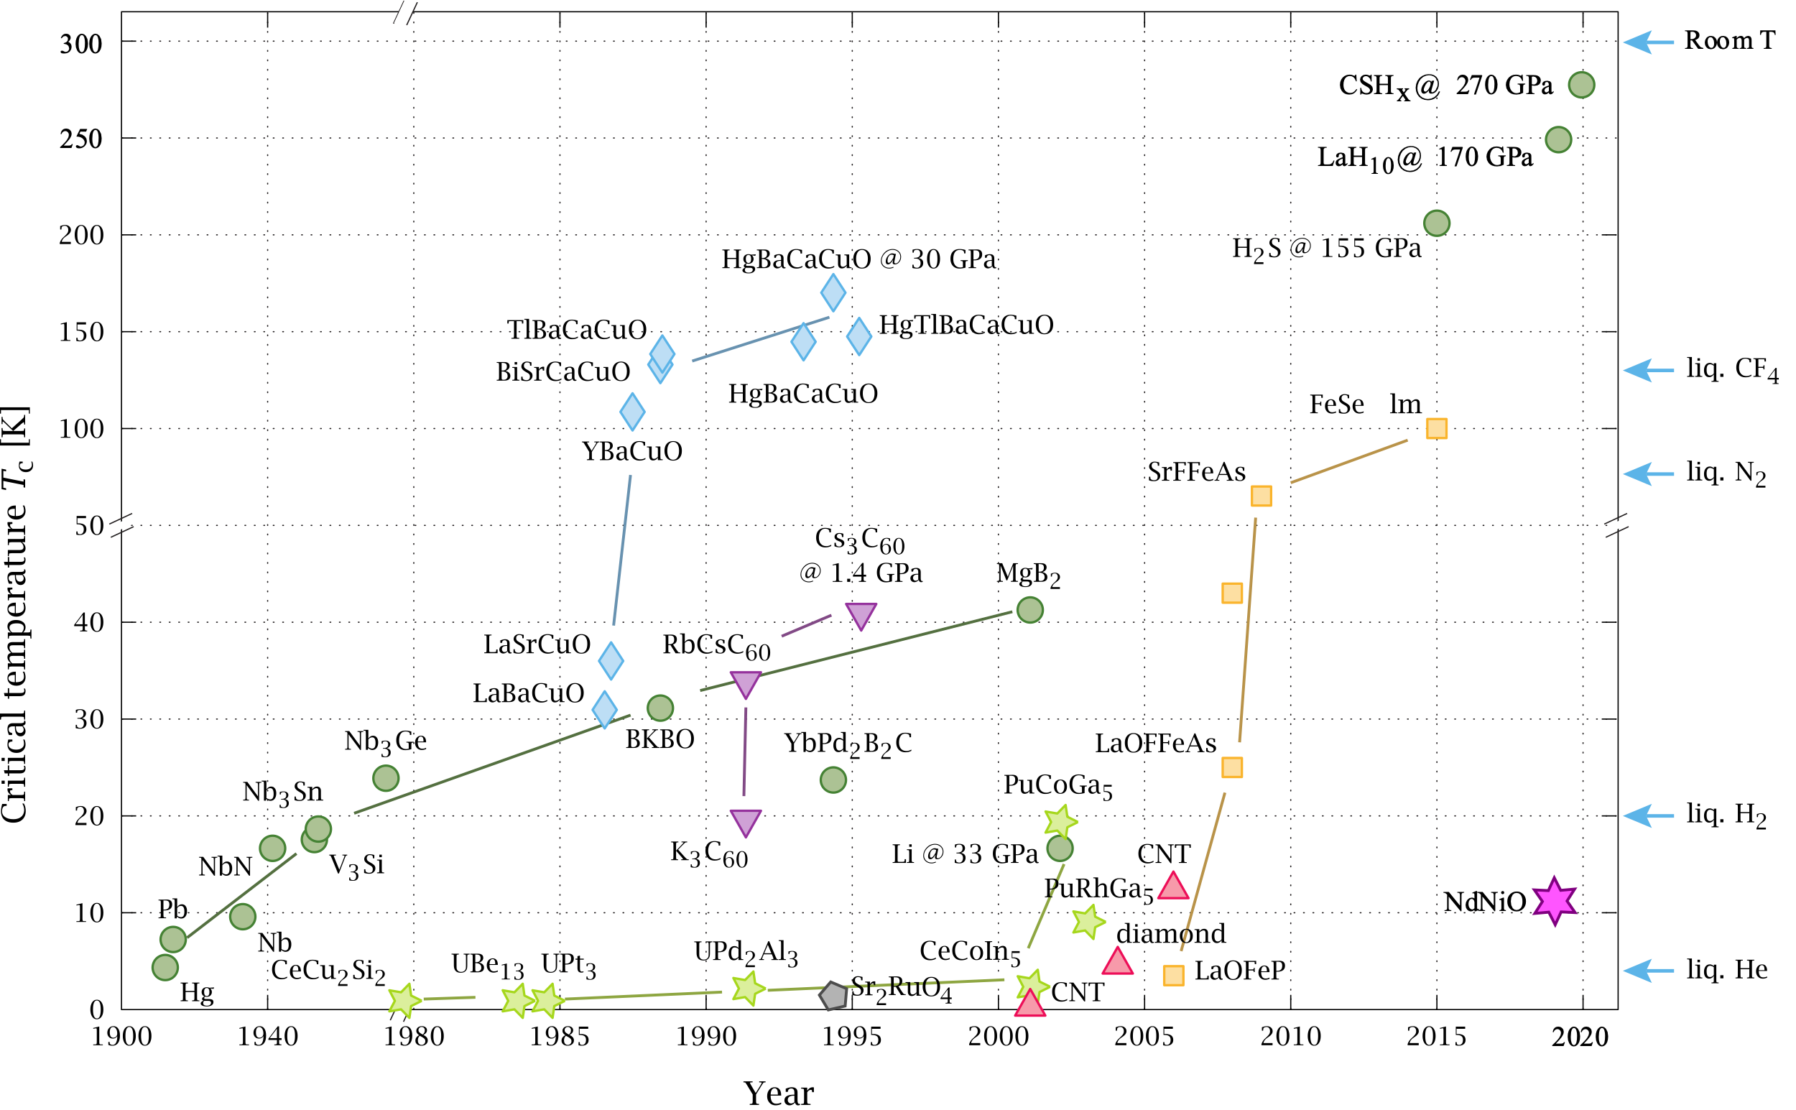
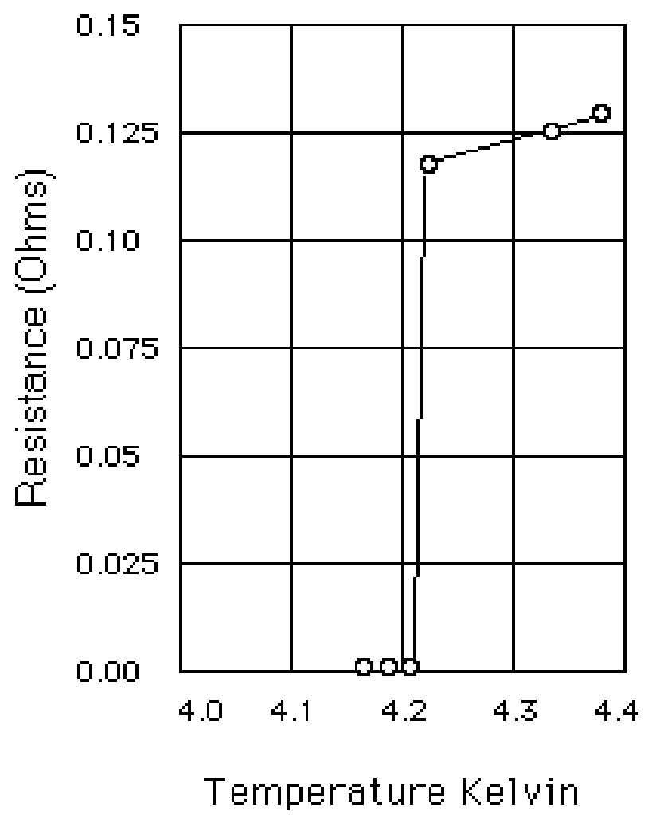
The history of Superconductivity
discovery of SC
liquefaction of Helium
Onnes
1911
The isotope effect 1950;
Energy gap 1956
BCS theory, 1957
Meissner effect
1933
1908
The mechnism of High Tc SC?
Bednorz and Müller
Iron-Based SC, 2008
Cuprate, 1987
Heavy Fermion SC, 1979
Notes:
1913: Nobel prize to Onnes:
"for his investigations on the properties of matter at low temperatures which led, interalia, to the production of liquid helium”.
约瑟夫森效应1973，Ginzburg2003。都不放了

Slide 4
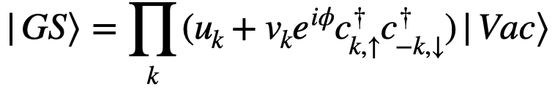
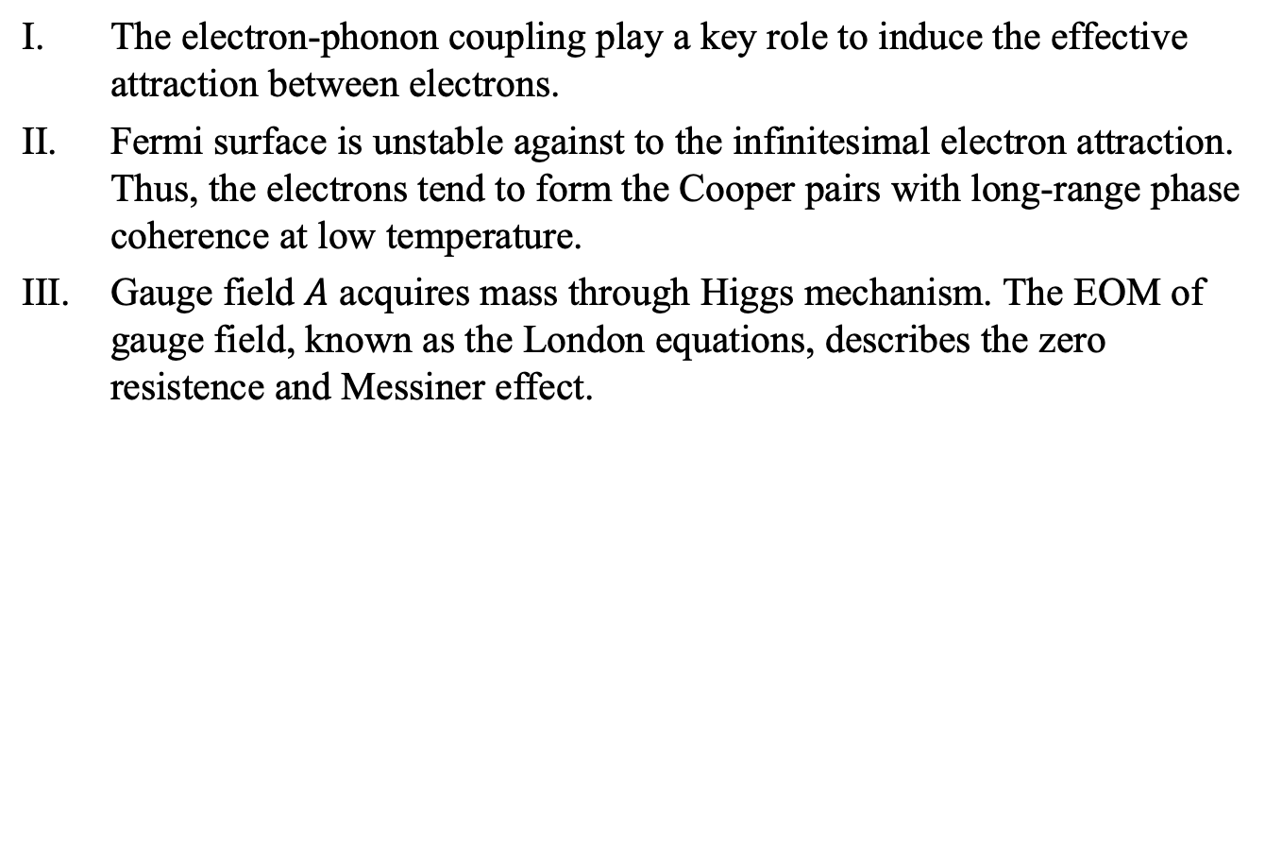
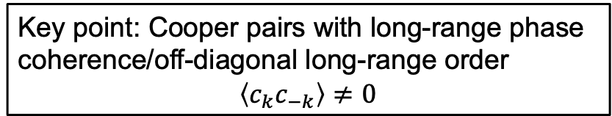
The mechanism of superconductivity: BCS theory
The electron-phonon coupling play a key role to induce the effective attraction between electrons.
Fermi surface is unstable against to the infinitesimal electron attraction. Thus, the electrons tend to form the Cooper pairs with long-range phase coherence at low temperature.
Gauge field $A$ acquires mass through Higgs mechanism. The EOM of gauge field, known as the London equations, describes the zero resistence and Messiner effect.
Key point: Cooper pairs with long-range phase coherence/off-diagonal long-range order
$$\left\langle c_{k}c_{−k}\right\rangle ≠0$$
Notes:
加图

Slide 5
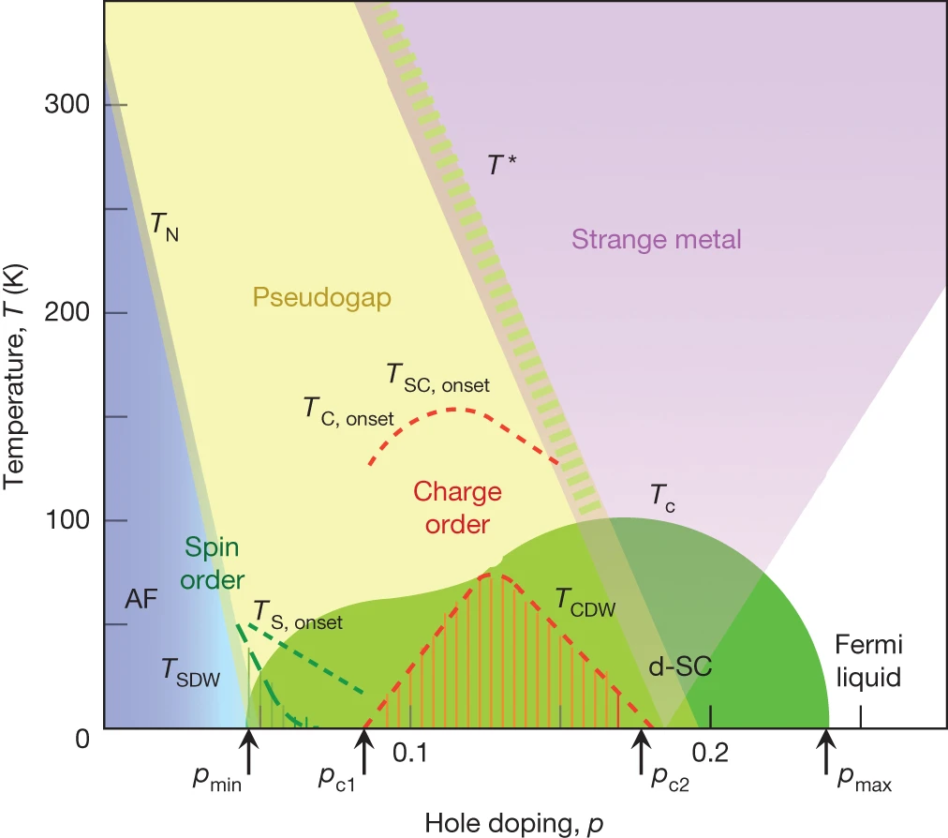
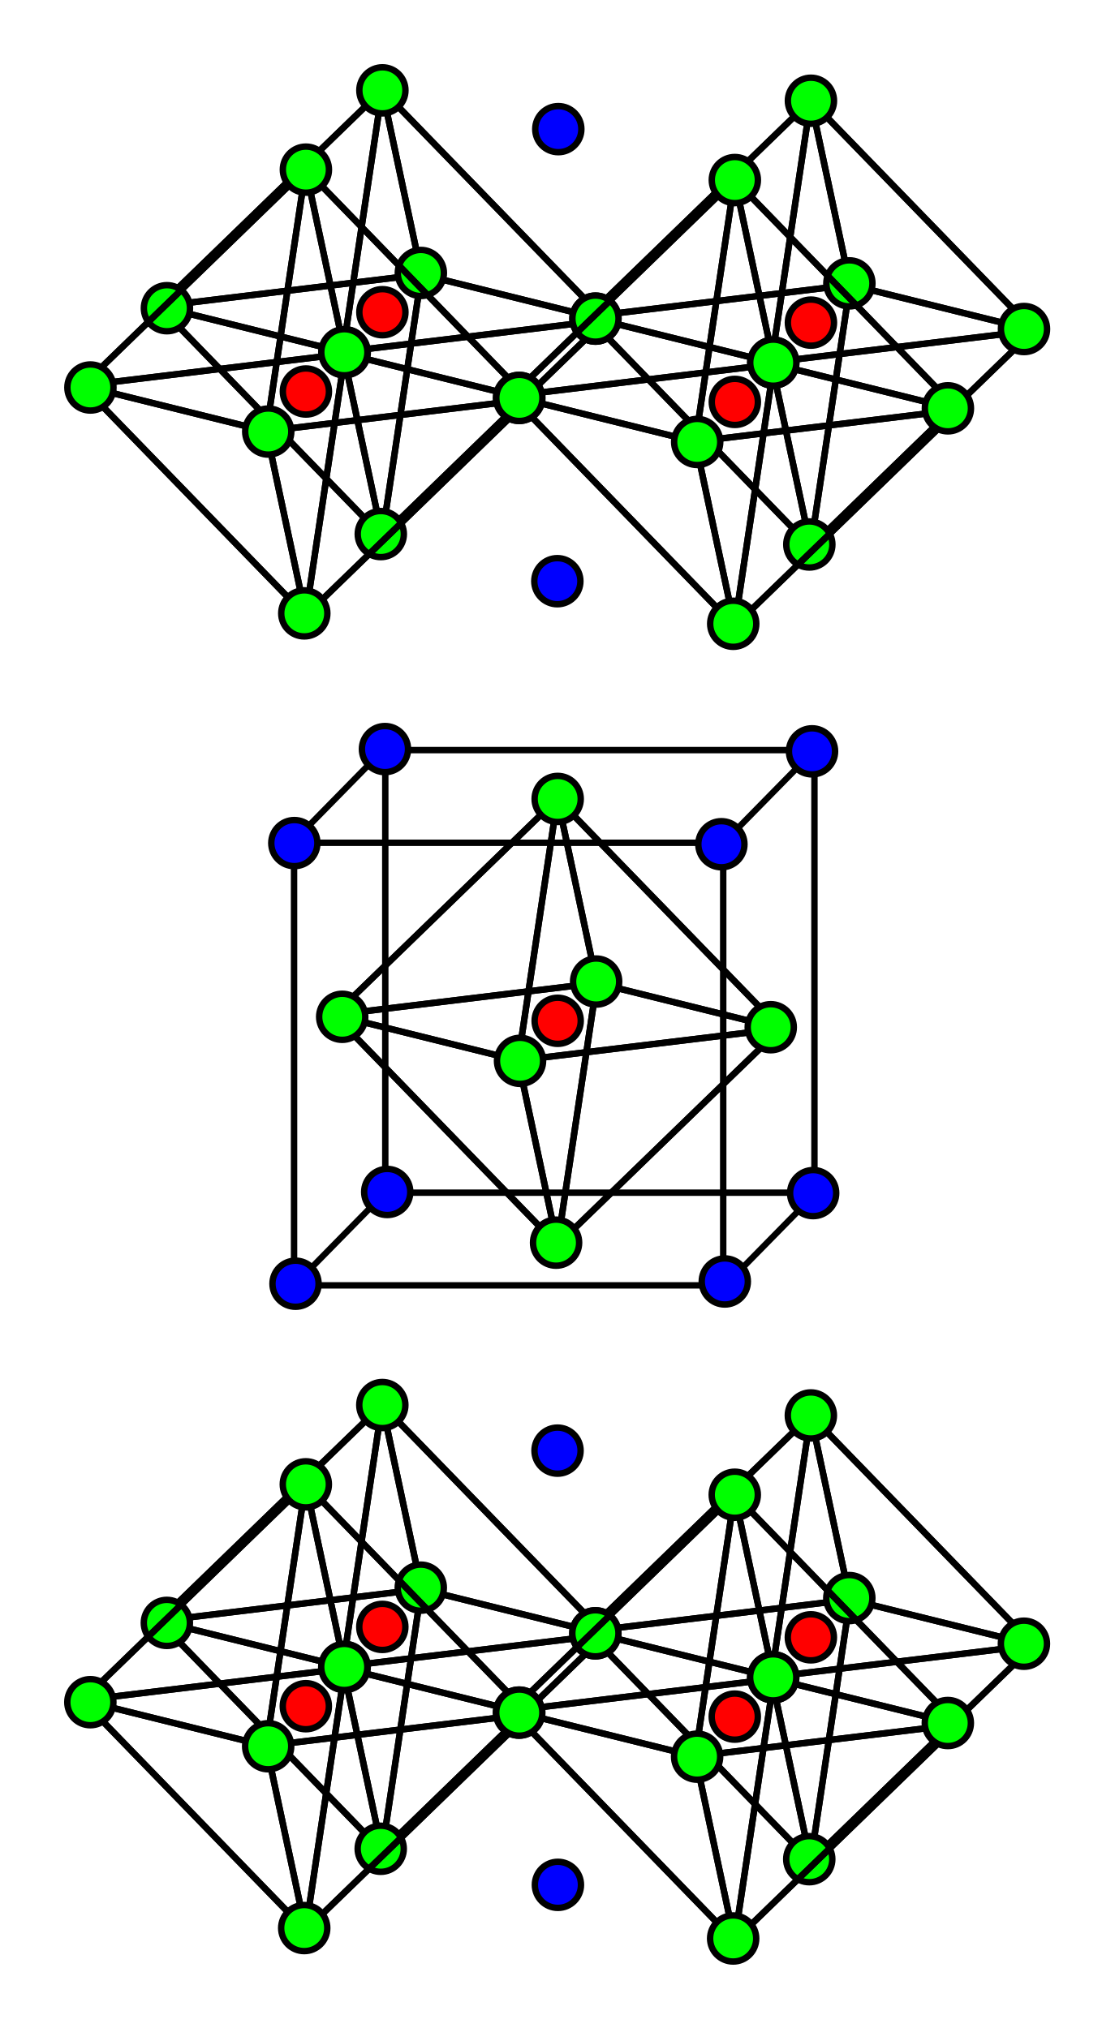
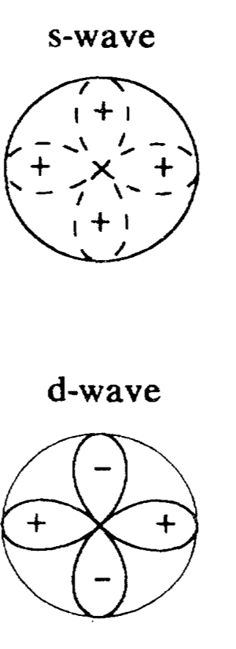
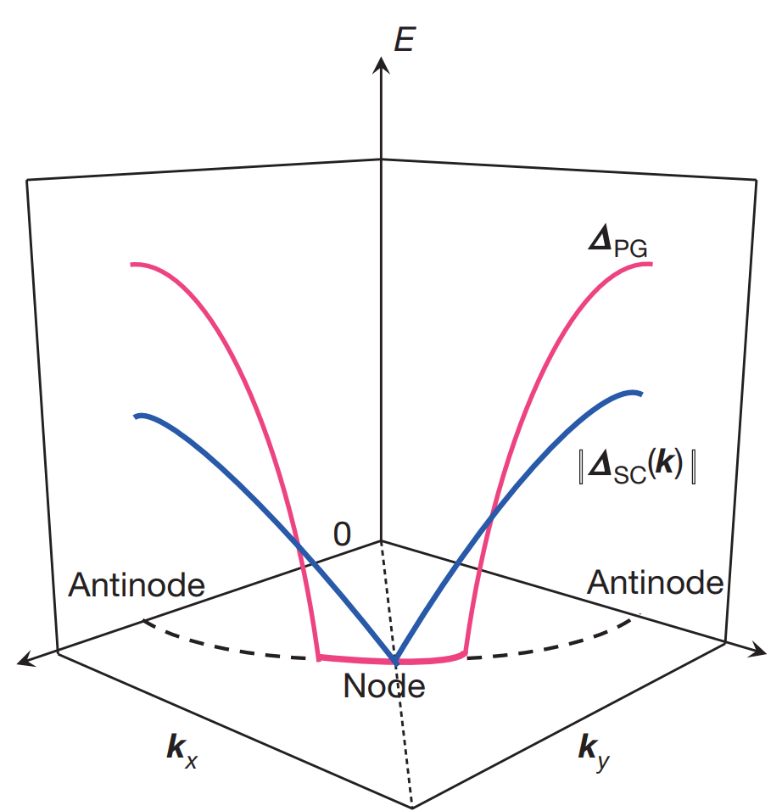
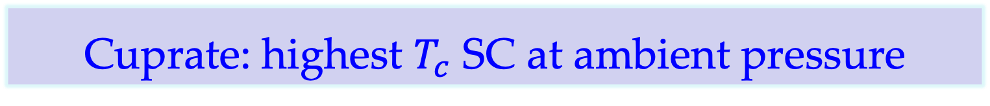
Cuprate: highest $T_{c}$ SC at ambient pressure
A general phase diagram for cuprate under hole doping
Crystallographic structure for La_{2-x}Ba_{x}CuO₄
CuO₂ plane
Charge reservoir
CuO₂ plane
Charge reservoir
CuO₂ plane
Mott insulator
[B. Keimer, et. al, Nature 2015]
Cu
La/Ba
O
Notes:
LBCO是1986Muller的诺贝尔奖。
Ba可以换成Sr。没有Ba的时候是电中性的，La是正3价，Ba是正2价，掺入Ba会让电荷库提供的电子减少，因而铜氧面上缺电子，产生空穴型掺杂。
正交晶系/斜方晶系
Mott绝缘体，就像交通堵塞一样, traffic jam
最佳掺杂大约在0.16, underdoped, overdoped.
Fermi Liquid相当于说电子穿梭是不受其他电子阻力的，所以dope少的时候还是强关联，但是dope足够就会进入Fermi liquid
onset: phase separation, the order occur on intermediate length scales.
red dashed line: CDW order
T_SDW: incommensurate SDW

Slide 6
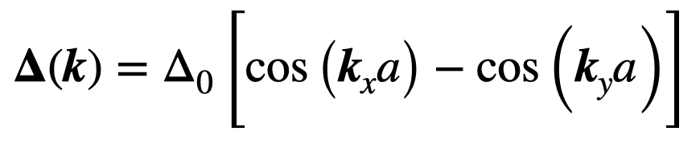
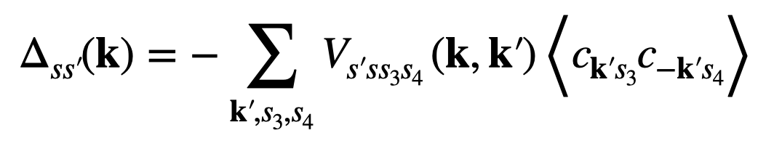
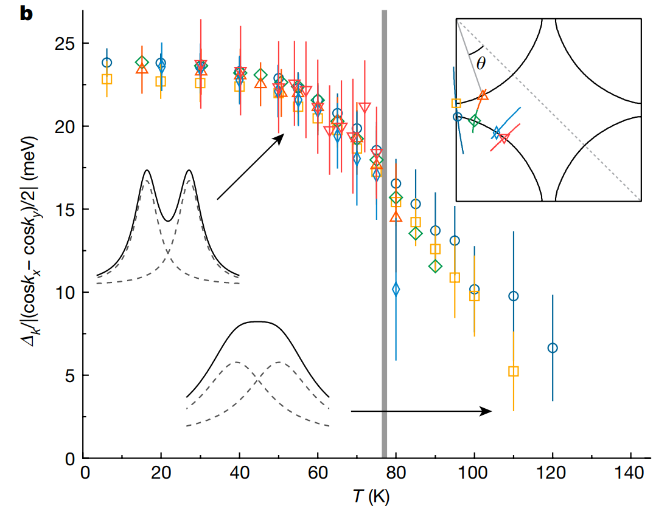
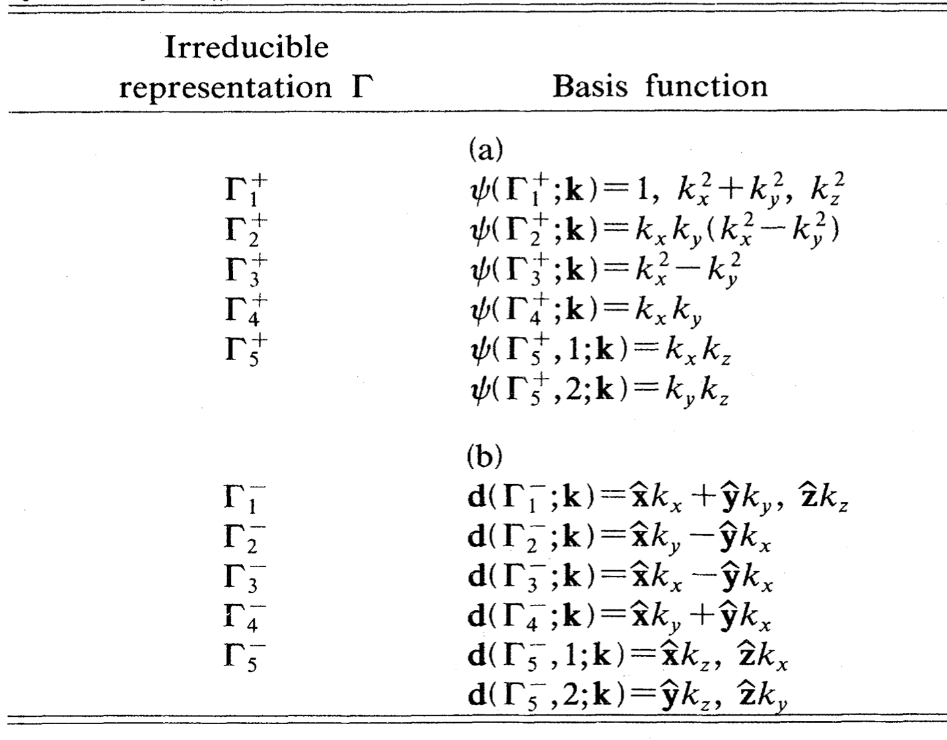
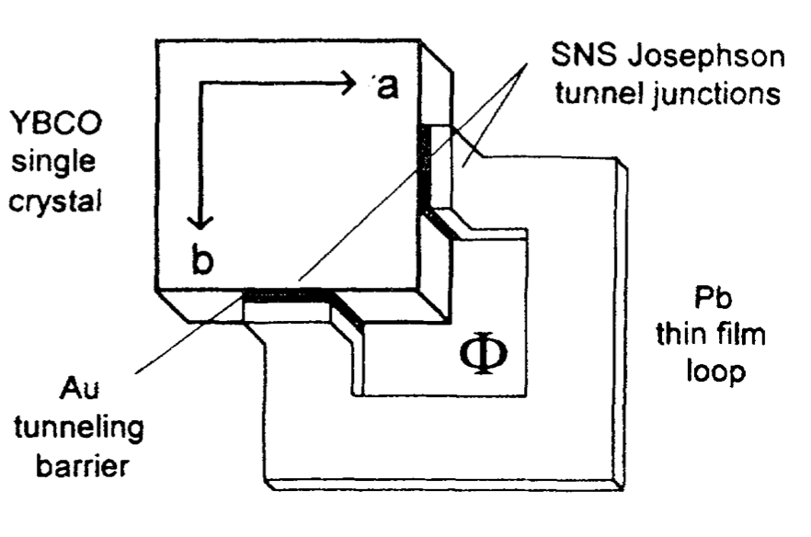
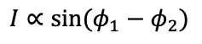
Pairing symmetry in cuprate: d-wave SC
gap function for $d_{x^{2}−y^{2}}$ paring symmetry
order parameter/gap function
gap function for tetragonal lattice (D_{4h})
[B. Keimer, et. al, Nature 2015]
[S.-D. Chen, et. al, Nature 2022]
Josephson current:
$$I∝\sin{(φ_{1}−φ_{2})}$$
[D. A. Wollman, et. al, PRL 1993]

Slide 7
The candidate theories for cuprate

Slide 8
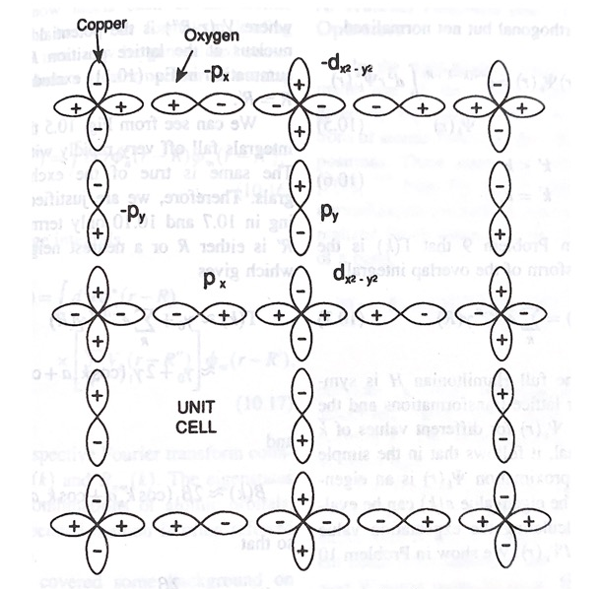


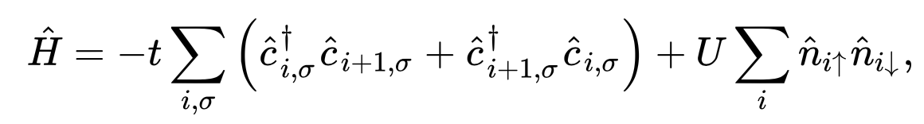
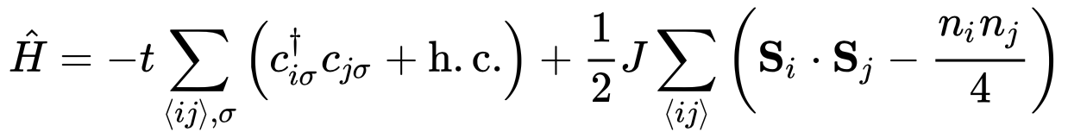
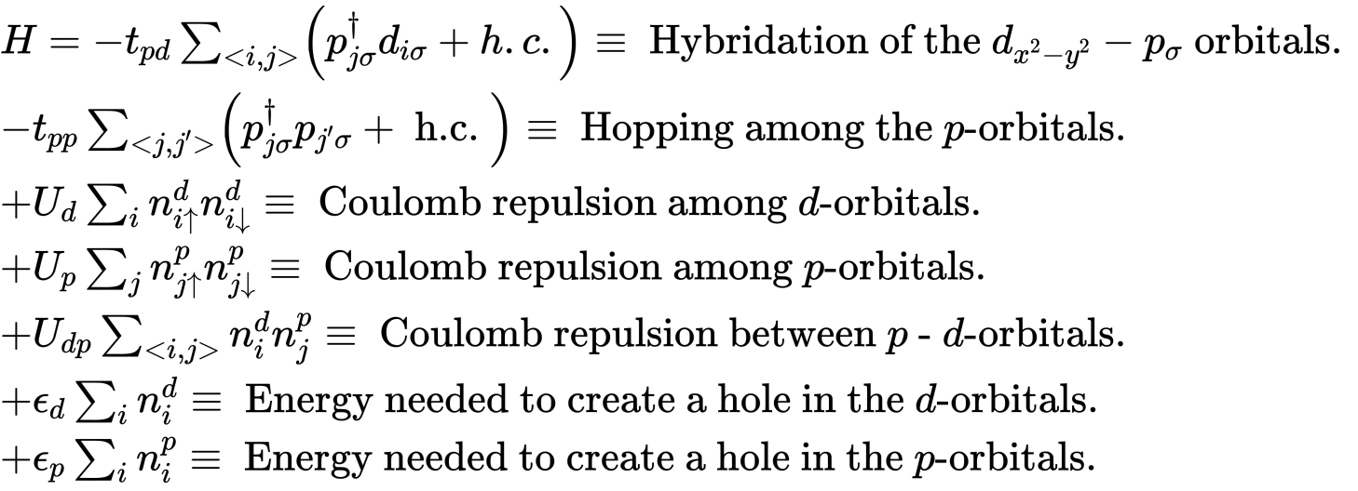
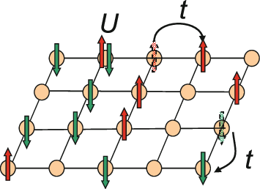
The models for Cu-O plane
Cu²⁺ : [Ar]3d⁹ O²⁻ : [He]2s²2p⁶
Zhang-Rice singlet: The hybridization strongly binds a hole on each square of O atoms to central Cu²⁺ ion to form a local singlet. This singlet then moves through the lattice of Cu²⁺ ions in a similar way as a hole in the single-band effective Hamiltonian. [Zhang and Rice 1988]
The Hubbard model:
The t-J model:
Three band Hubbard model:
In the past 40 years, it is widely believed that these two models can used to describe d-wave SC.

Slide 9

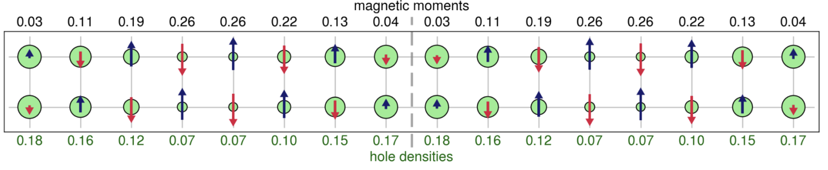
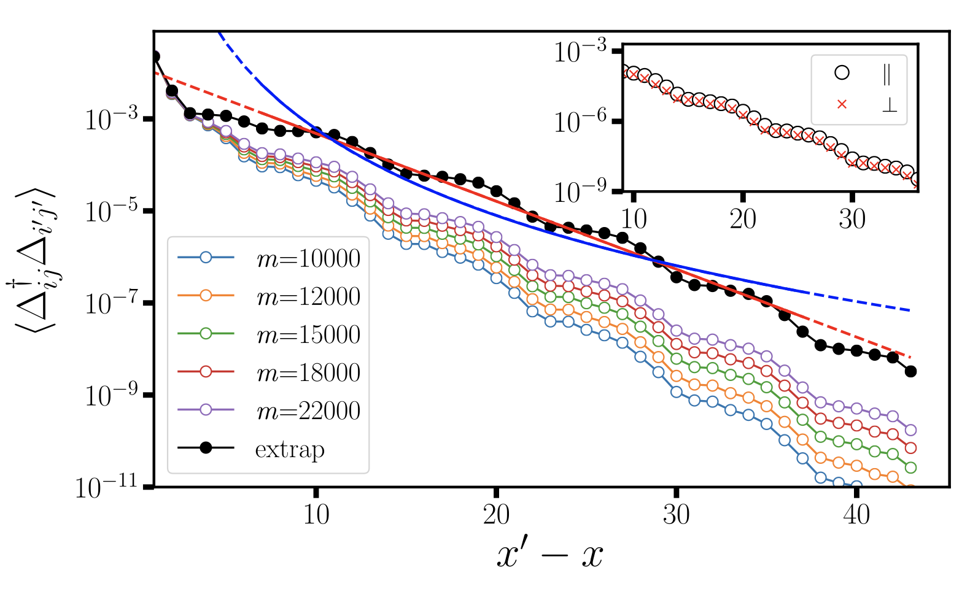
d-wave SC in the Hubbard model
Recent numerical studies suggested that the simplest Hubbard model with strong Hubbard interactions in doping range relevant for hole-doped cuprate SC exhibits stripe order or phase separation but no d-wave superconductivity in the ground state.
Mingpu Qin, el. al, PRX 2020;
B.-X. Zheng, el. al, Science 2017;
J. P. F. LeBlanc, el. al, PRX 2015;
DMRG calculated charge and spin order
DMRG calculated SC correlation
Notes:
It has been nearly forty years since the experimental discovery of high-temperature superconductivity. [J. G. Benordz and K. A. Muller, 1986]

Slide 10
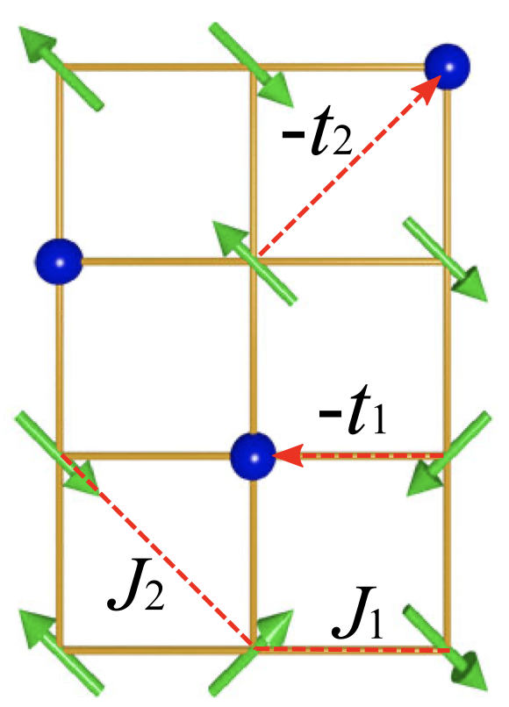
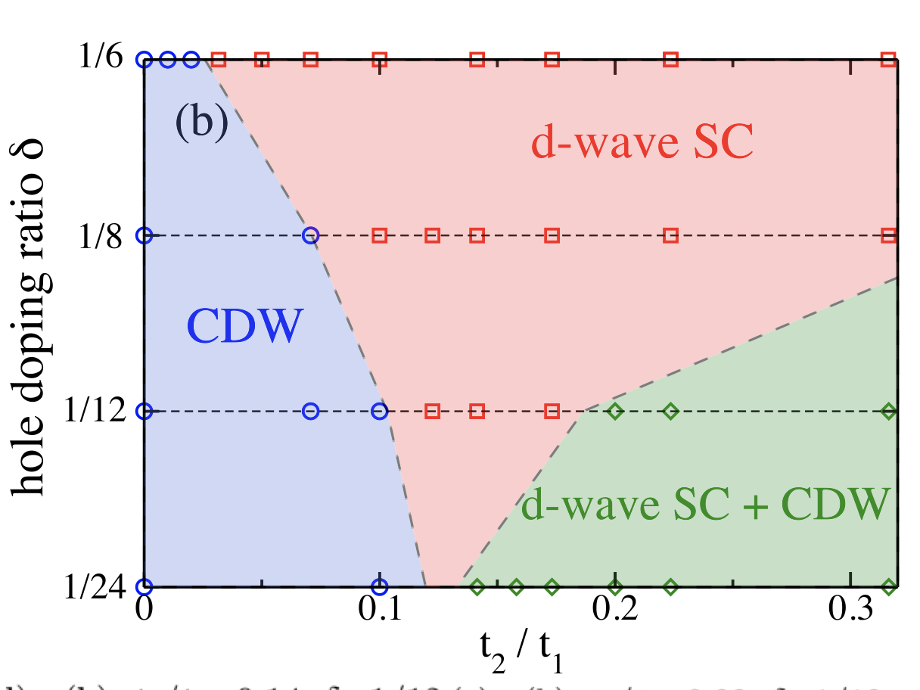
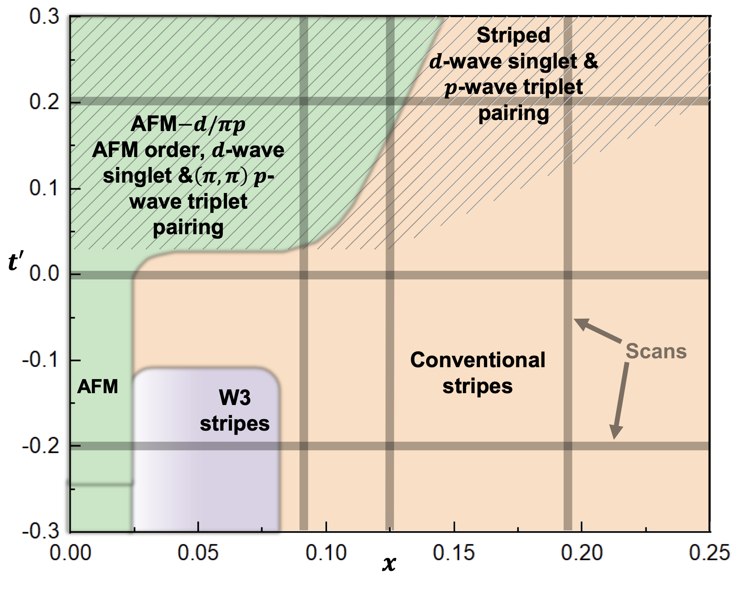
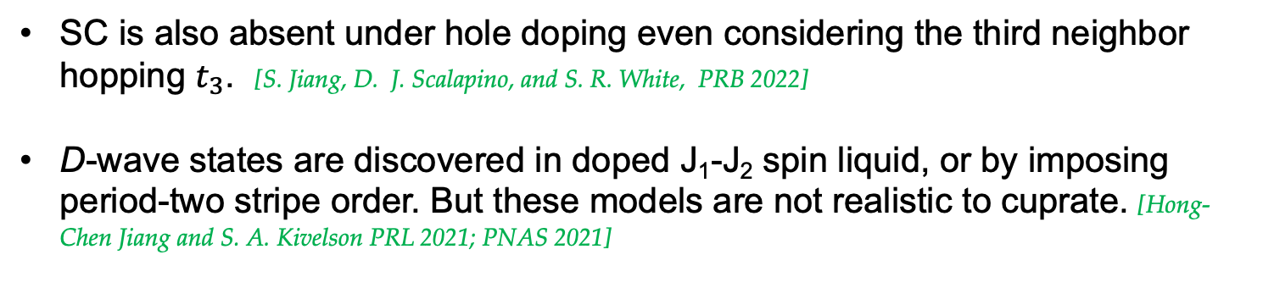
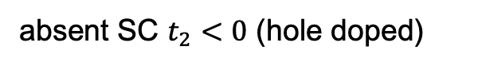
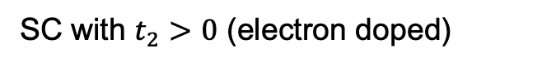

The road to the microscopic mechanism for d-wave SC
What more is needed beyond the Hubbard model?
The next nearest neighbor hopping $t_{2}$
SC with $t_{2}>0$ (electron doped)
absent SC $t_{2}<0$ (hole doped)
D. N. Sheng, et. al PRL 2021
S. Jiang, D. J. Scalapino, and S. R. White, PNAS 2021
SC is also absent under hole doping even considering the third neighbor hopping $t_{3}$. [S. Jiang, D. J. Scalapino, and S. R. White, PRB 2022]
D-wave states are discovered in doped J₁-J₂ spin liquid, or by imposing period-two stripe order. But these models are not realistic to cuprate. [Hong-Chen Jiang and S. A. Kivelson PRL 2021; PNAS 2021]
Notes:
Relevent work for t2, Corboz iPEPS PRB 100, 195141

Slide 11
The road to the microscopic mechanism for d-wave SC
recent numeric evidences
The Hubbard or t-J model
with the consideration of t₂
What kind of model can describe the d-wave SC in cuprate?
with the consideration of t₂ and t₃
The Hubbard model with electron-phonon coupling:
Important ingredient from the experimental point of view But less be considered

Slide 12
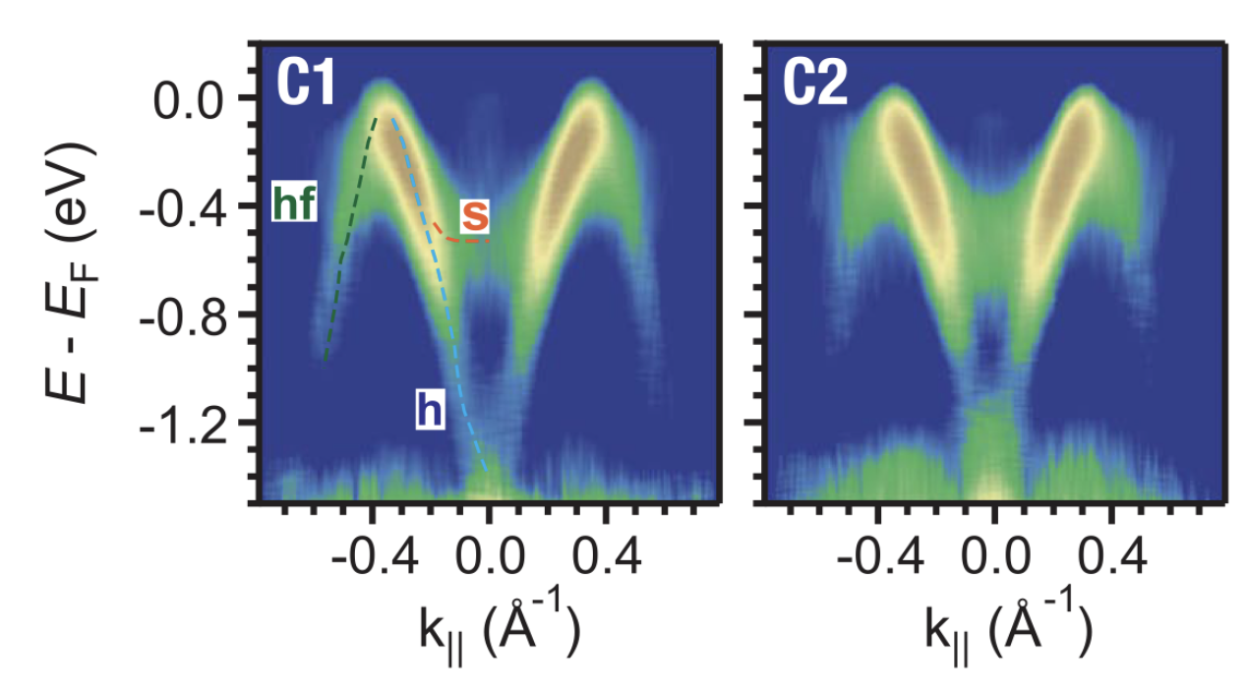
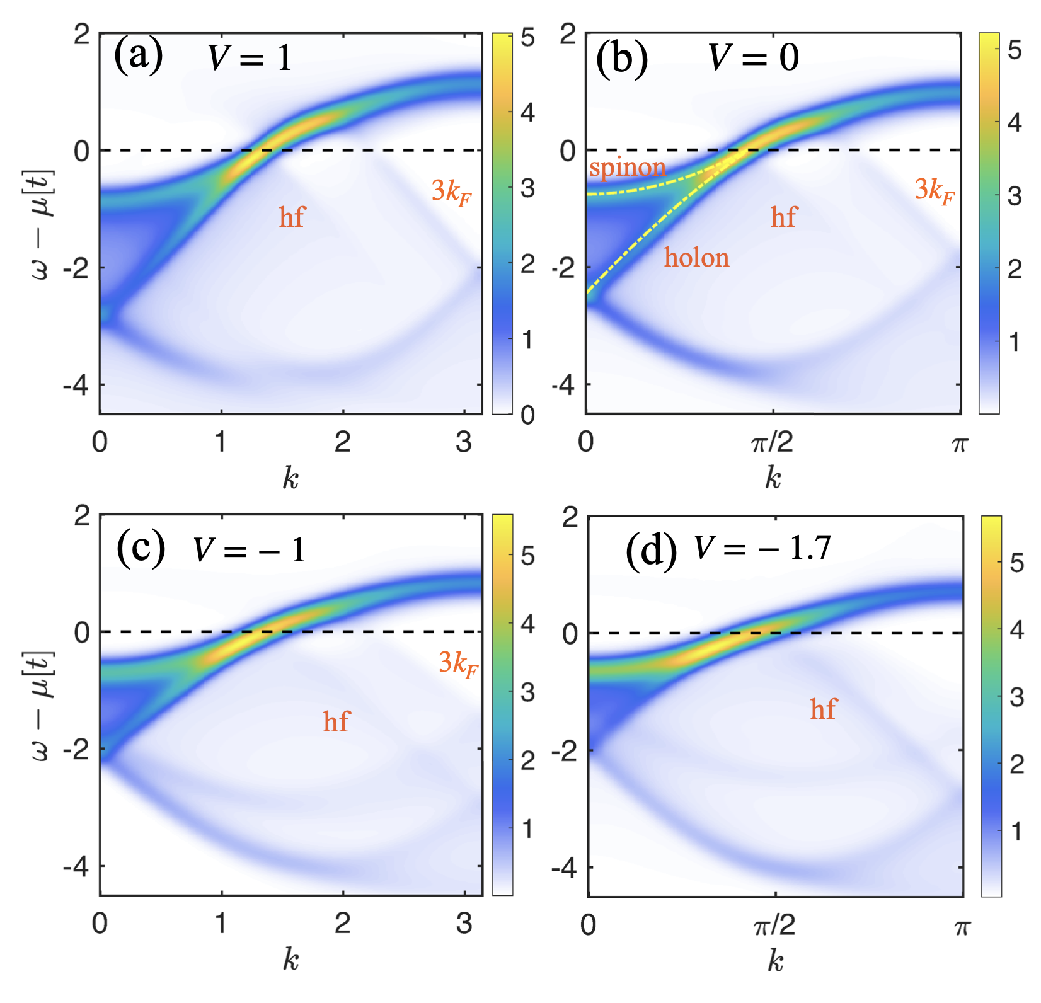
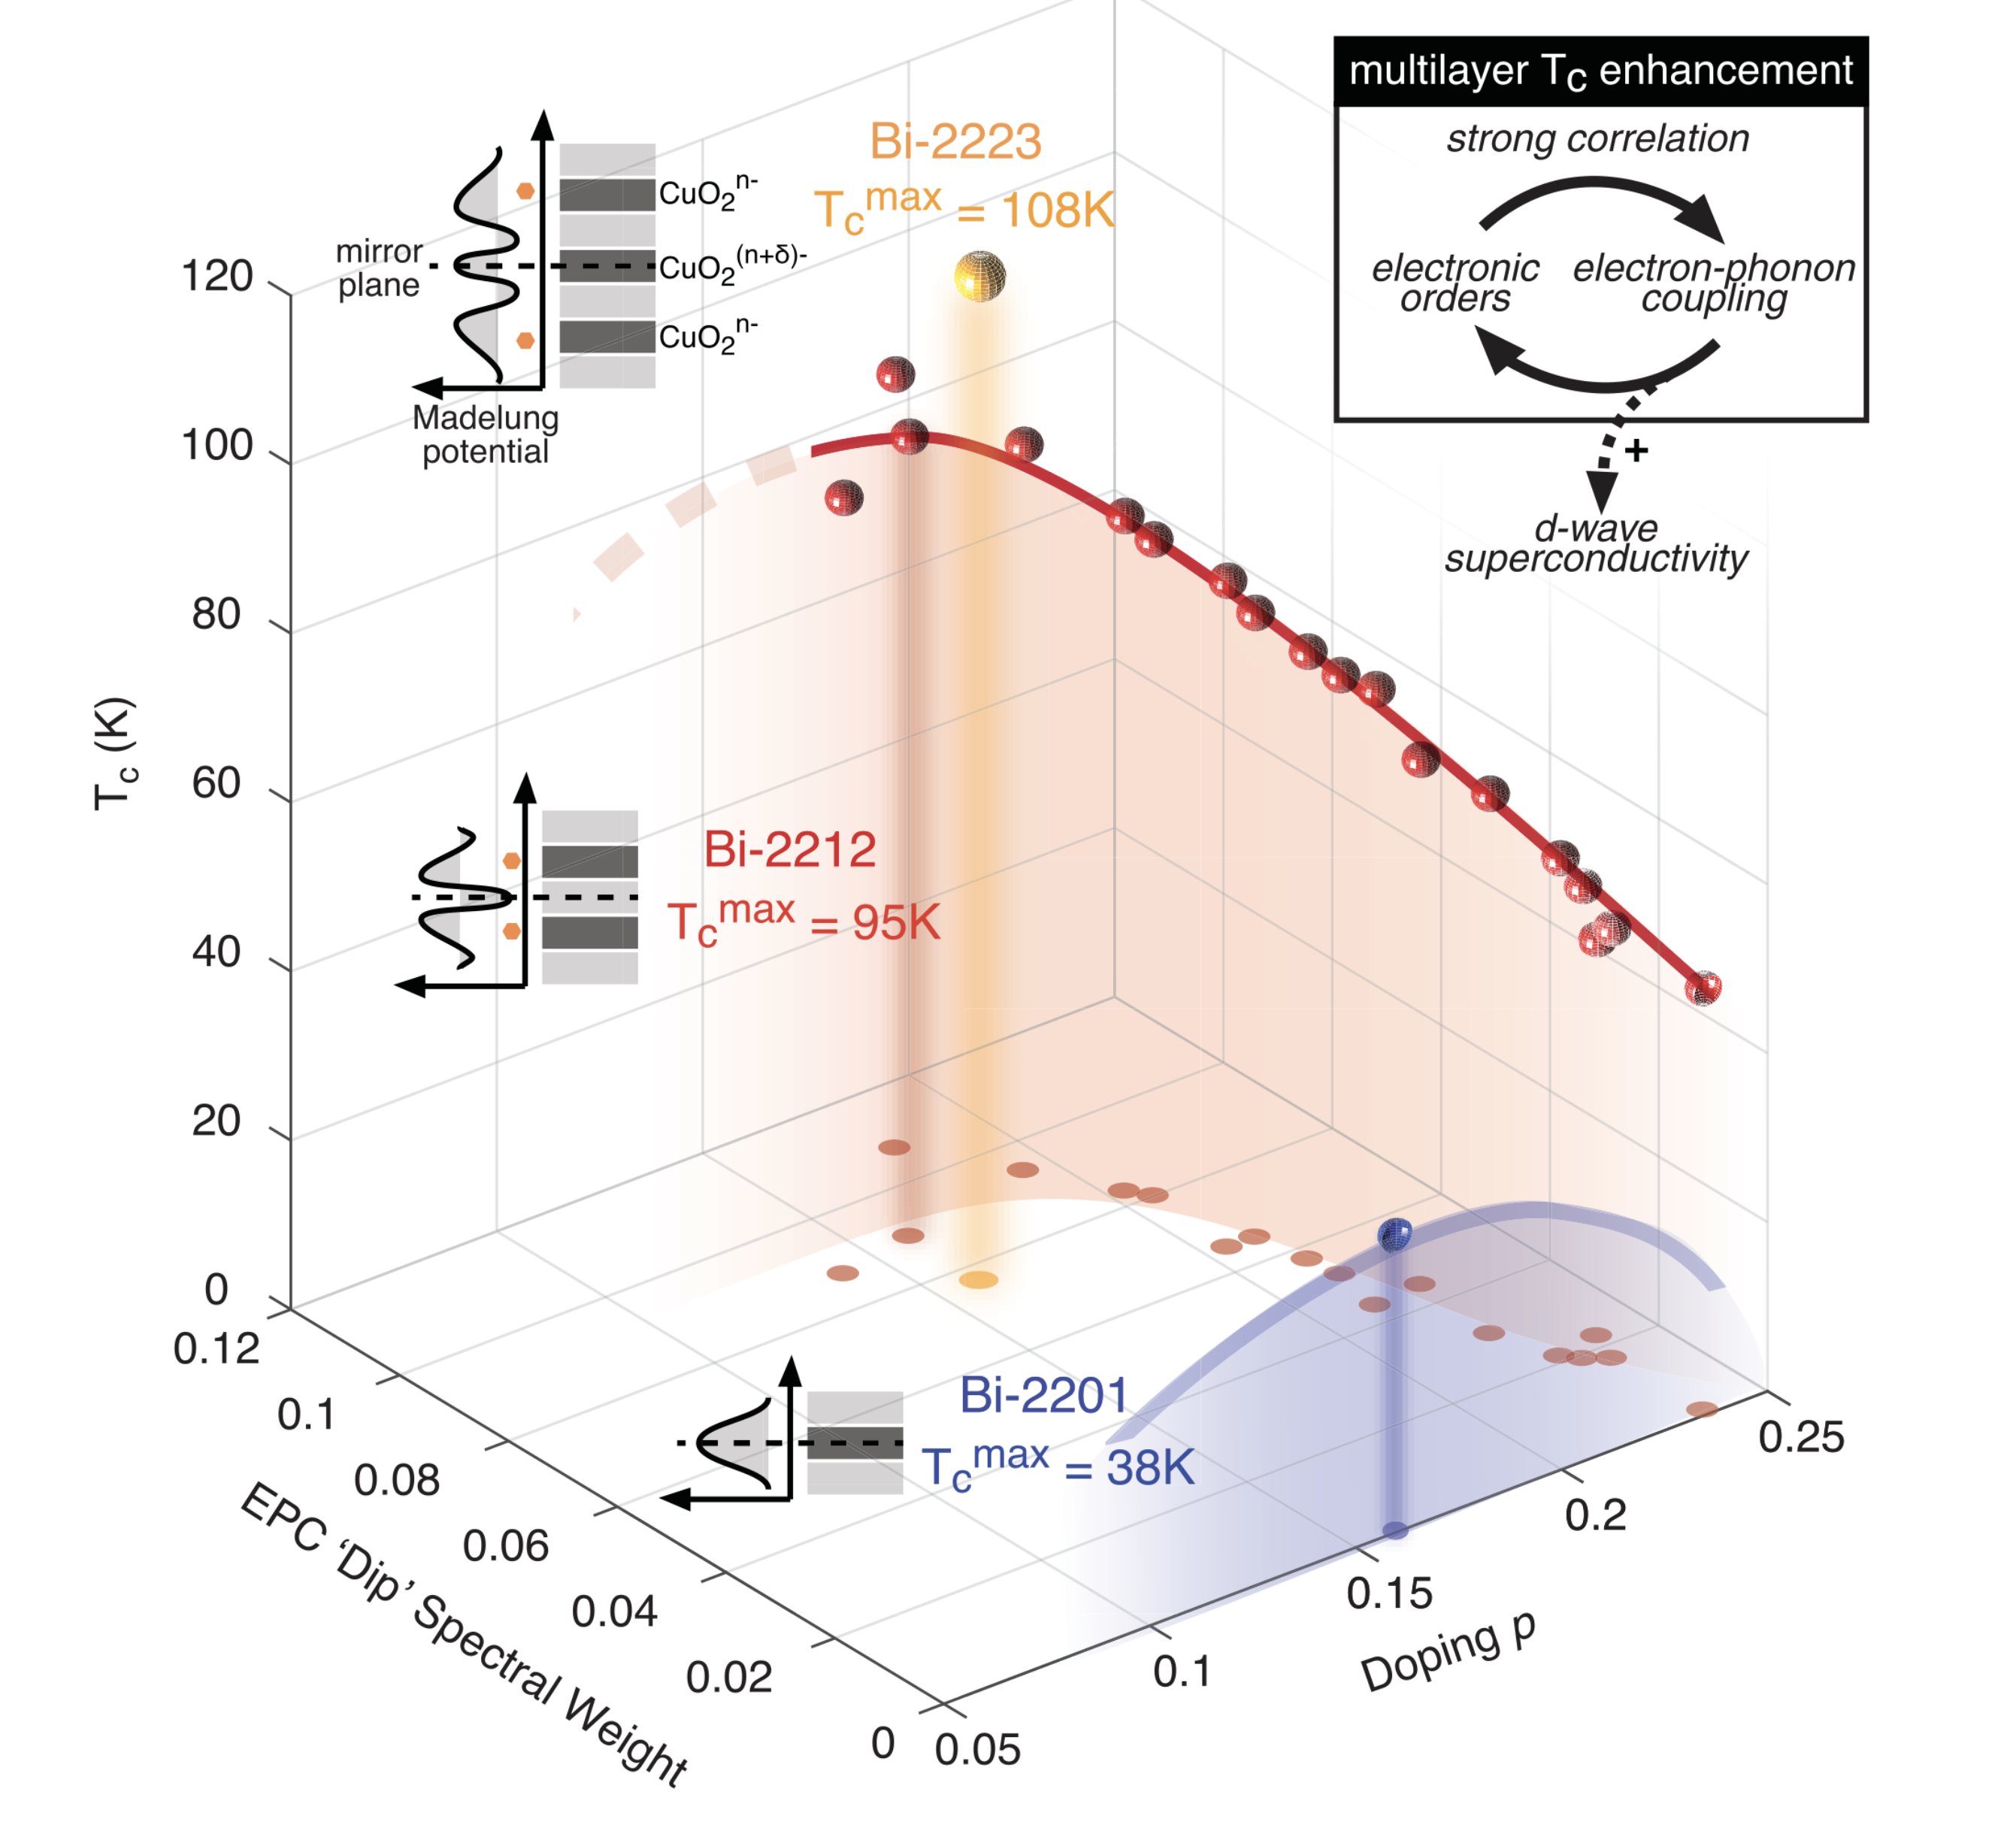
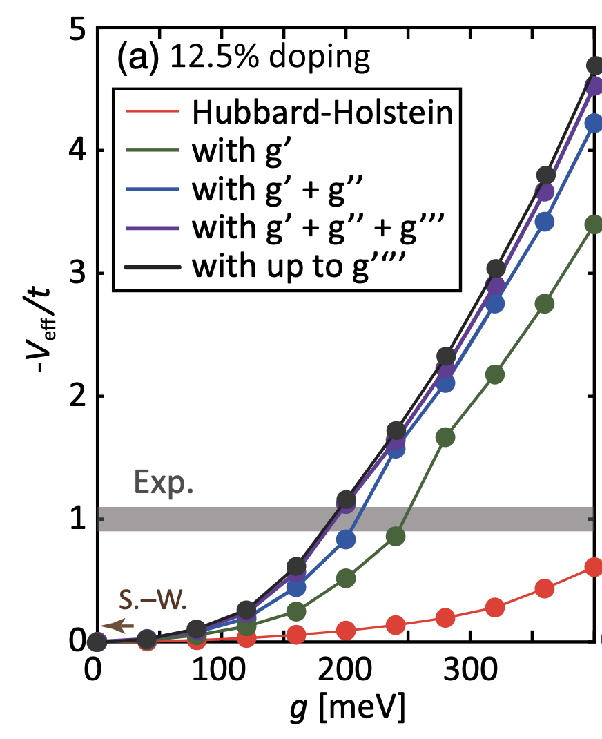
Electron-phonon coupling
Increasing experimental and theoretic researches indicate that EPC can be an essential ingredient in high-T_{c} superconductors, including cuprates and iron-based superconductors.
[Z. Chen, Z.-X. Shen et al.,Science (2021)]
intertwined growth of the superconductivity and EPC
[Y. He, Z.-X. Shen et al.,Science (2018)]
[Y. Wang et al.,PRL (2021)]
HXW, HY et. al, arXiv:2211.02031
Notes:
EPC drives the formation of Cooper pairs in conventional superconductivity.

Slide 13
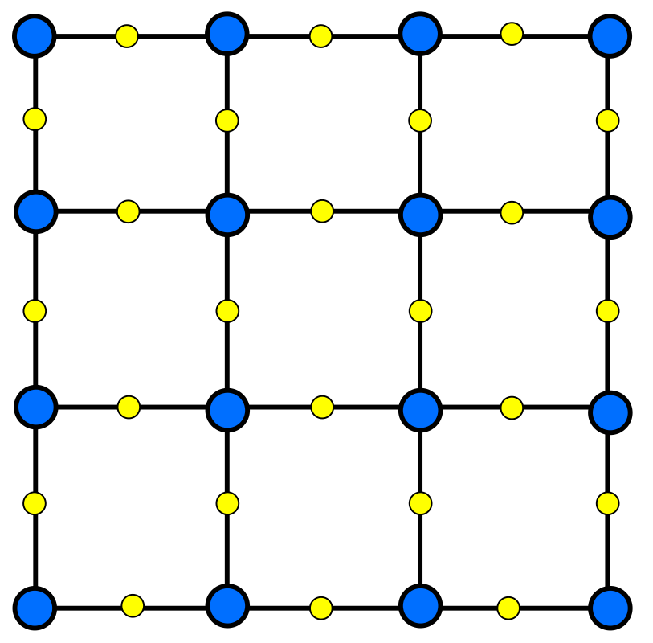
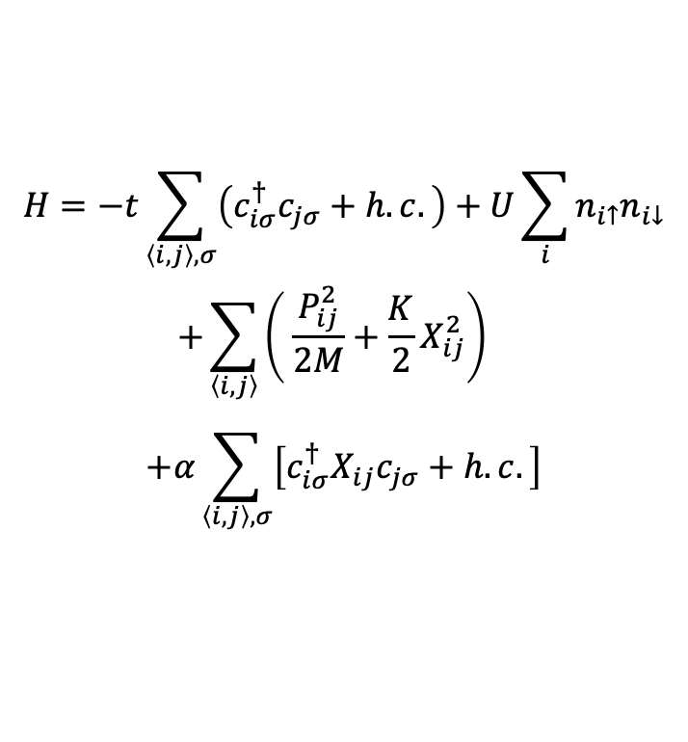
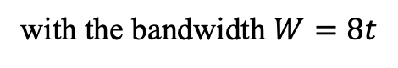
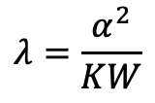
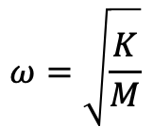
The Su-Schrieffer-Heeger-Hubbard model
The Hamiltonian of SSHH model:
$$H=−t\sum_{\left\langle i,j\right\rangle ,σ}{\left(c_{iσ}^{†}c_{jσ}+h.c.\right)}+U\sum_{i}{n_{i↑}n_{i↓}}$$
$$+\sum_{\left\langle i, j\right\rangle }{\left( \frac{P_{ij}^{2}}{2M}+\frac{K}{2}X_{ij}^{2}\right)}$$
$$+α\sum_{\left\langle i, j\right\rangle ,σ}{\left[c_{iσ}^{†}X_{ij}c_{jσ}+h.c.\right]}$$
$$ω=\sqrt{\frac{K}{M}}$$
Phonon frequency:
electron site
phonon site
The dimensionless EPC constant:
$$λ=\frac{α^{2}}{KW}$$
The model might be relevant to the physics of CuO₂ plane considering B_{1g} phonons.
with the bandwidth $W=8t$
Xun Cai, Zi-Xiang Li, and HY, PRL (2021)

Slide 14
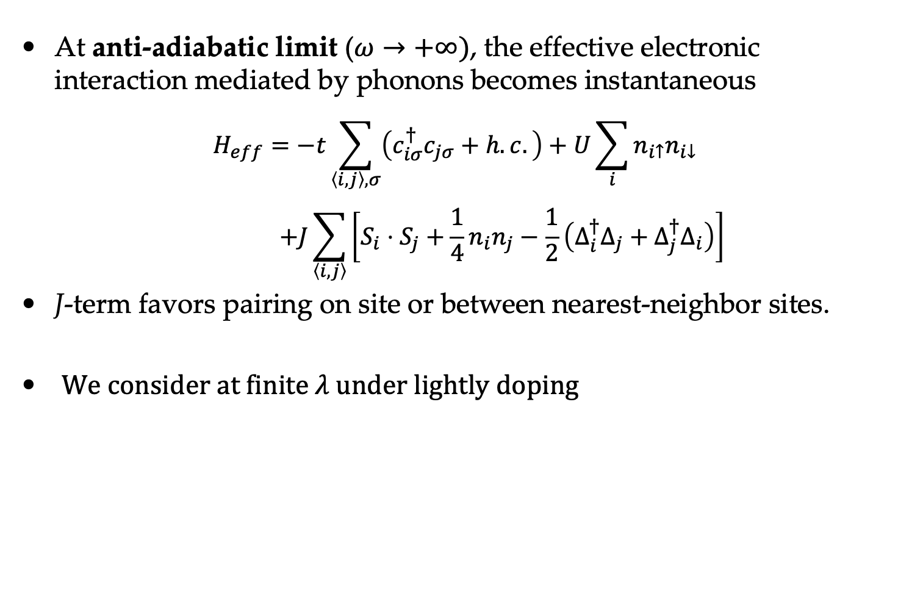
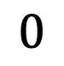
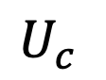
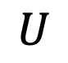

Limit analysis
At anti-adiabatic limit ($ω→+∞)$, the effective electronic interaction mediated by phonons becomes instantaneous
$$H_{eff}=−t\sum_{\left\langle i,j\right\rangle ,σ}{\left(c_{iσ}^{†}c_{jσ}+h.c.\right)}+U\sum_{i}{n_{i↑}n_{i↓}}$$
$$+J\sum_{\left\langle i, j\right\rangle }{\left[S_{i}⋅S_{j}+\frac{1}{4}n_{i}n_{j}−\frac{1}{2}\left(Δ_{i}^{†}Δ_{j}+Δ_{j}^{†}Δ_{i}\right)\right]}$$
J-term favors pairing on site or between nearest-neighbor sites.
We consider at finite 𝜆 under lightly doping
$$J=\frac{2α^{2}}{K}=2λW$$
$$0$$
$$U$$
$$U_{c}^{}$$
d-wave SC ?
BCS, s-wave SC

Slide 15
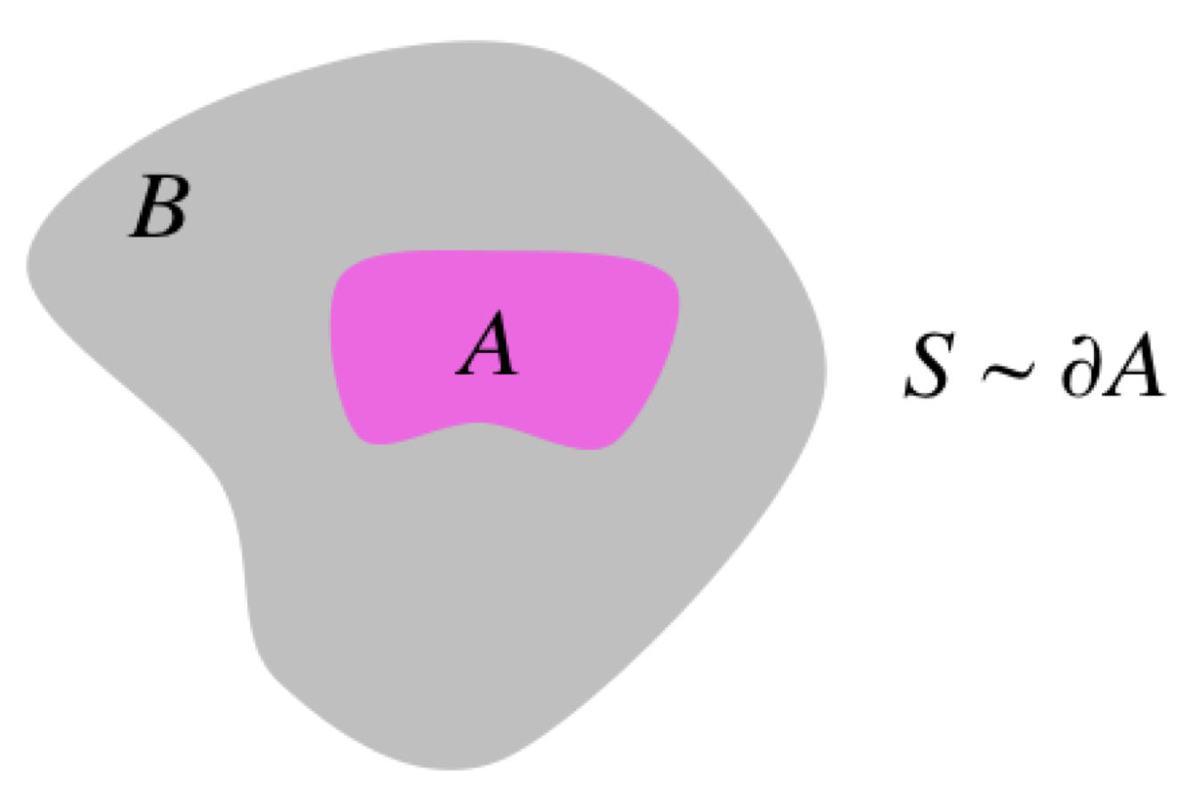
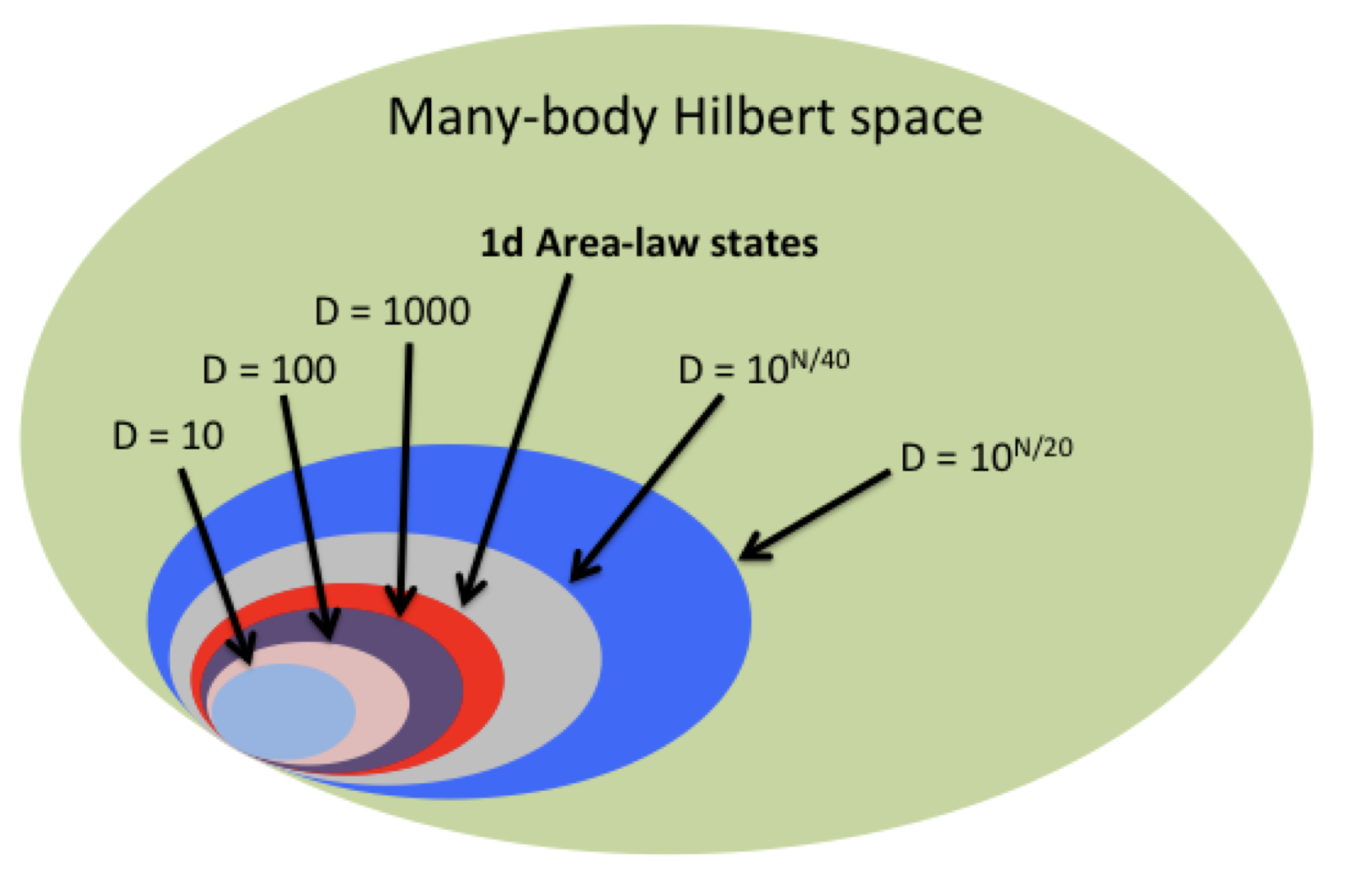
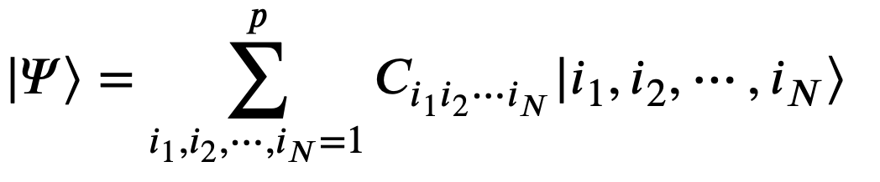
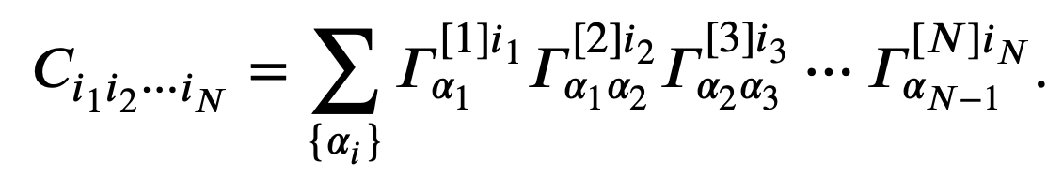
Method: Density Matrix Renormalization group
The DMRG is a numerical variational technique devised to obtain the low-energy physics of quantum many-body system with high accuracy. It is nowadays the most efficient method for 1D systems.
Matrix Product State
,
Orus
Notes:
21世纪的费曼图

Slide 16


Phase Diagram
We employ a large-scale DMRG calculation for the SSHH model on four-leg ladders, and get the quantum phase diagram as a function of SSH electron-phonon coupling $λ$ and Hubbard $U$:
s-wave SC phase: dominant quasi-long-range on-site SC correlation and subdominant quasi-long-range charge density correlation;
stripe CDW phase: short-range SC correlation and long-range CDW ordering;
d-wave SC phase: dominant SC correlation with d-wave symmetry and subdominant charge-density correlation;
In the phase diagram, we fix the phonon frequency $ω_{D}=5$, and doping level concentration $δ=0.125$.
Longer in x-direction. A quasi 1D system.
arXiv:2211.09143, HXW, Y.-F. Jiang and Hong Yao

Slide 17





s-wave state
half-filled stripe state with wave length 4;
quasi-long range SC correlation with $K_{sc}<1$;
susceptibility $χ_{SC}=∫dr^{D}dtΦ\left(r,t\right)$
if $K_{sc}<2, χ_{SC}$ will be divergent.
Subleading quasi-long-ranged charge order
a spin gapped
Luther-Emery Liquid
(b)
(c)
$$K_{c}=2.4(2)$$
$$K_{sc}=0.56(2)$$
(d)
$$D\left(r\right)=\left\langle n\left(0\right)n\left(r\right)\right\rangle ∝{\left|r\right|}^{−K_{c}}$$
Spin correlation
Notes:
Charge density profile on Lx = 48
superconductivity correlation
charge density correlation
spin correlation

Slide 18







d-wave state
Half-filled stripe state.
The amplitude of charge density wave (CDW), $A_{cdw}$ decay algebraically as system size increasing: a charge gapless state.
$$A_{cdw}∝L^{−K_{c}/2}$$
d-wave SC correlations decay in a polynomial form, with $K_{sc}<$1. It indicates a divergent SC susceptibility
pairing symmetry: plaquette d-wave & ordinary d-wave
Spin gapped.
$$K_{c}≃1.35$$
$$K_{sc}≃0.94$$
$$ξ_{s}=3.54$$
$$K_{sc}≃0.77$$
Notes:
The wave length of charge density is $4$, so-called half-filled stripe state.
The amplitude of charge density wave (CDW), $A_{cdw}$ decay algebraically as system size increasing, indicating a charge gapless state.
(d), (e), SC correlation on Lx=32 cylinder

Slide 19


SC evolution from s-wave to d-wave
s-wave pairing
d-wave pairing
$$U$$
When fixing $λ$, i.e. $λ$ = 0.3, and gradually increasing $U$ from zero, the onsite Hubbard repulsion naturally suppresses the onsite s-wave pairing tendency but leaves the bond d-wave pairing channel nearly unaffected.

Slide 20


stripe state
$$(λ=0.1, U=8)$$
Renowned filled-stripe as in the Hubbard model
Short range SC correlation
The filled-stripe phase is stable against small $λ.$

Slide 21

Conclusions
From the state-of-the-art DMRG calculations, we have shown that the interplay between moderate SSH-type EPC and strong Hubbard 𝑈 on the square lattice can induce a d-wave SC state, which is a SC dominant Luther-Emery liquid state.
The d-wave SC states obtained for strong $U$ and moderate $λ$ could have potential relevance for understanding the d-wave SC in cuprates in the future studies.
Thank you for your attention!

